Slide 1

A PROJECT
ON
WEATHER PREDICTION
BACHELOR OF TECHNOLOGY
IN
COMPUTER SCIENCE AND ENGINEERING
BY
ADARSH P R 23VE1A05k3
MALOTHU SIDDHU 23VE1A05N0
VALLURI NAGESHWARI 23VE1A05R3
ENJETI DEEPTHI 24VE5A0521
ACADEMIC BATCH: 2023-2027
Under the Guidance of
Mr. M. Hari Prasad

Slide 2
Testing - Definition and Types:
Testing Definition: Testing is the process of evaluating a system or its components to find whether it satisfies the specified requirements. The goal is to identify any errors, gaps, or missing requirements.
Types of Testing Used:
Unit Testing – Checking individual components like the weather API call and ML prediction logic.
Integration Testing – Verifying if API responses integrate well with output display logic.
Functional Testing – Ensuring the input (city name/humidity & pressure) gives the correct temperature output.
Manual Testing – Used for command-line inputs and CSV data-based predictions.

Slide 3
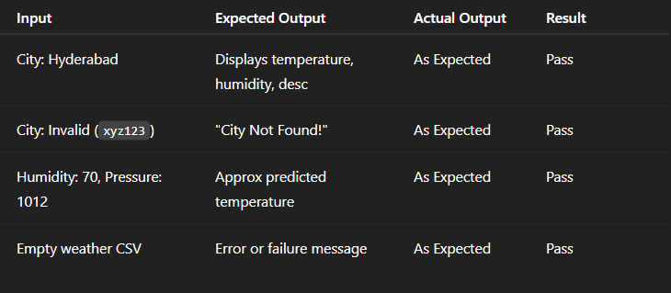
Test Cases:

Slide 4
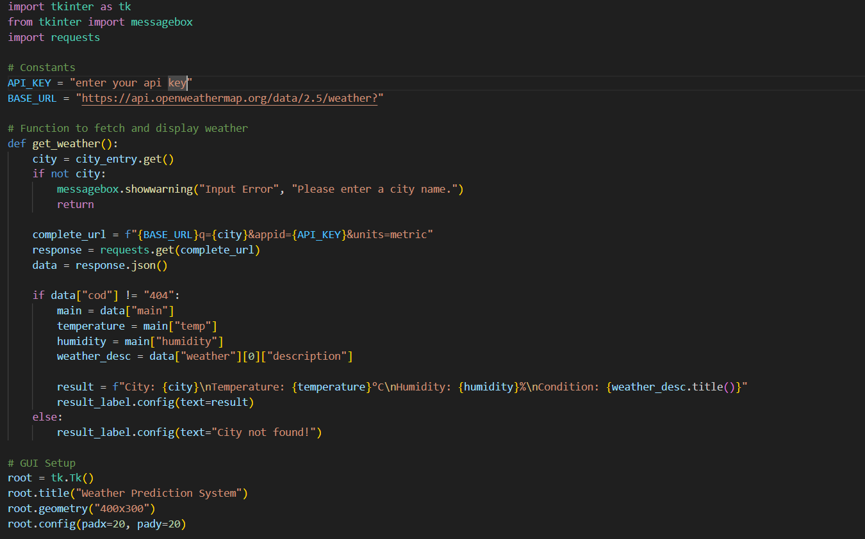
Code: Main
Enter your API key………....

Slide 5
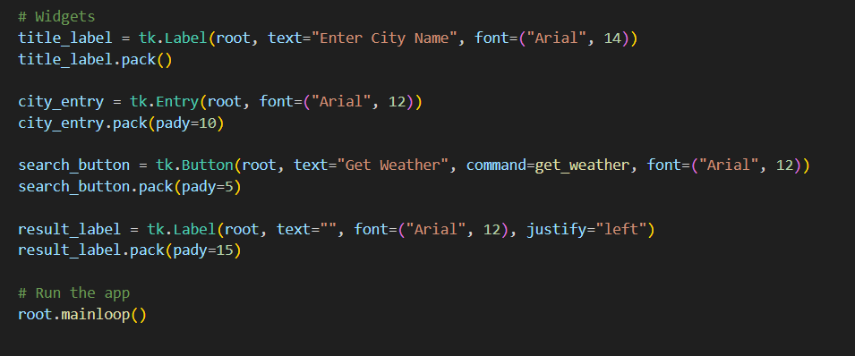

Slide 6
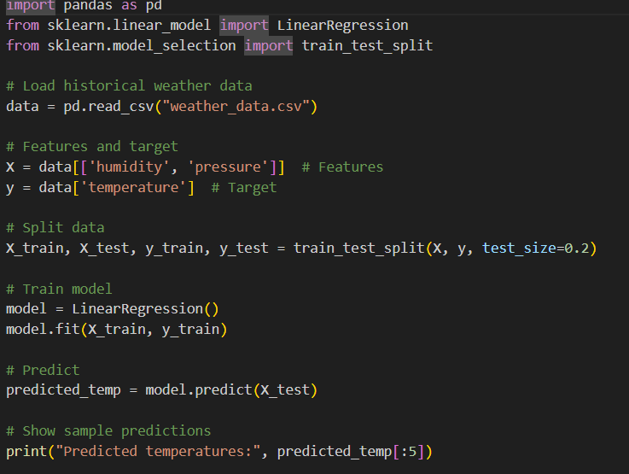
Code 2

Slide 7
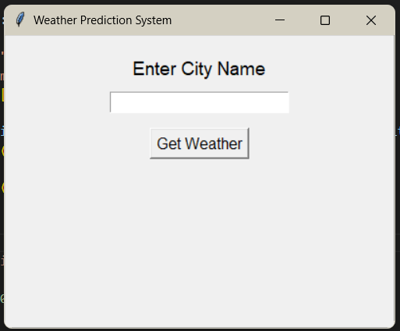
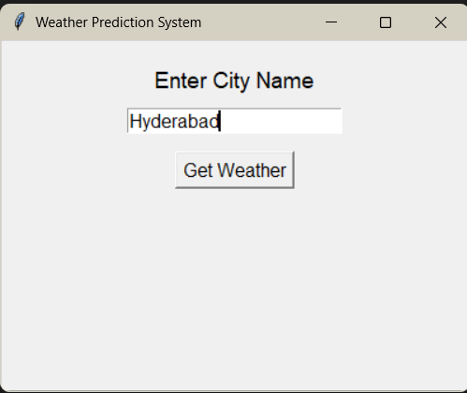
Output Screenshot :

Slide 8
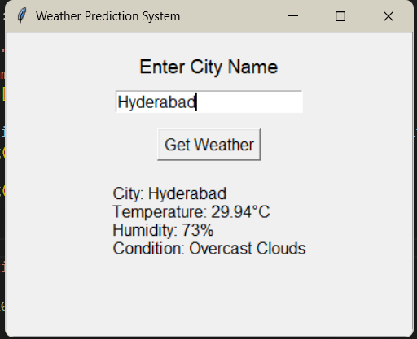
Output Screenshot (ML Prediction Program):

Slide 9
Limitations of the Project:
Requires an active internet connection for API-based data.
The prediction accuracy depends heavily on the quality of historical weather data.
City input in wp1.py must be correctly spelled; no autocomplete or correction support.
The ML model is simplistic, using only two features (humidity, pressure) and linear regression.

Slide 10
Future Scope or Enhancements:
Add more features to the ML model (wind speed, cloud cover, etc.) for better accuracy.
Build a GUI using Tkinter or a web framework for better user interaction.
Include data validation and city suggestion/autocomplete.
Deploy as a full-stack application with live updates and forecasts.

Slide 11
Conclusion:
The project successfully integrates real-time weather reporting with machine learning-based temperature prediction.
It demonstrates practical use of APIs and ML algorithms.
There is significant scope for future upgrades in accuracy, UI, and deployment.
A solid foundation for understanding both data science and software development life cycles.

